Slide 1
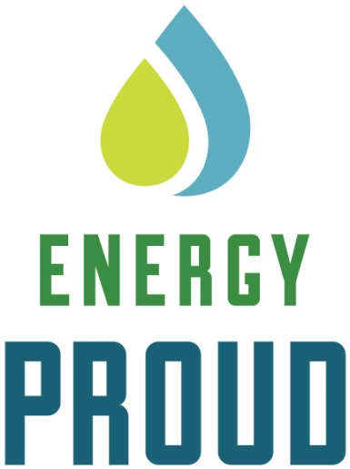
WESTERN STATES PETROLEUM ASSOCIATION
Hydraulic Fracturing and Energy Production in California
May 2014

Slide 2
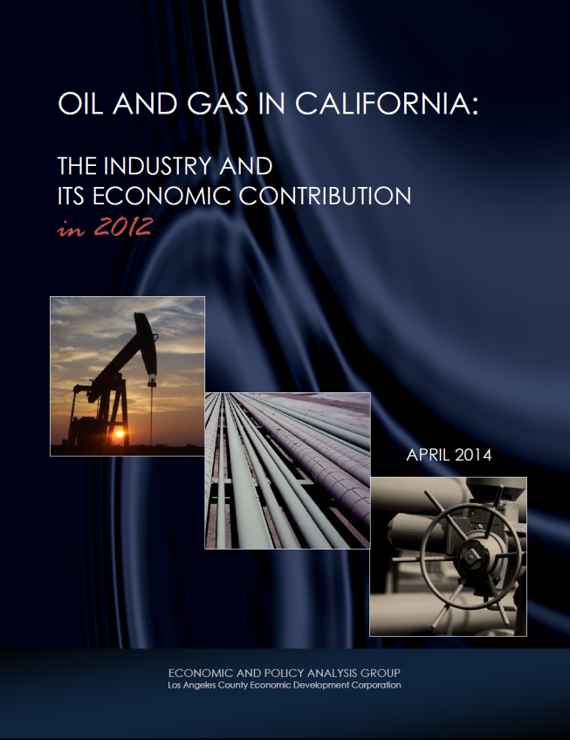
WESTERN STATES PETROLEUM ASSOCIATION
Petroleum Industry & California Economy
Employment (direct and indirect) Statewide: 468,000 So Cal: 212,220
Labor income Statewide: $39.8 billion So Cal: $16.9 billion
State and local taxes Statewide: $21.5 billion So Cal: $10.6 billion
Value Added Statewide: $112.8 billion So Cal: $ 46.6 billion
2

Slide 3
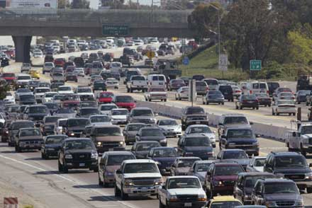
WESTERN STATES PETROLEUM ASSOCIATION
California Energy Facts
96 percent of California’s transportation fuels are petroleum based – gasoline, diesel, jet fuel
3
Source: California Energy Commission

Slide 4
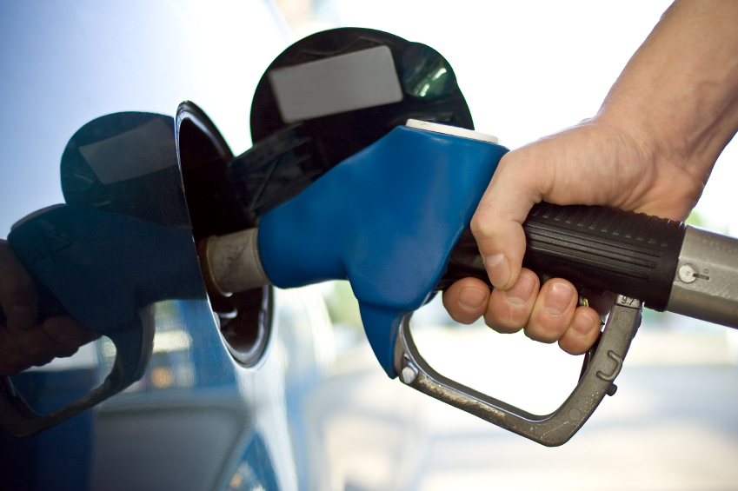
WESTERN STATES PETROLEUM ASSOCIATION
California Energy Facts
We consume 43 million gallons of gasoline, 14 million gallons of diesel fuel and 11 million gallons of jet fuel every day
That’s almost 3 million gallons of fuel every hour, every day, 365 days a year
4
Source: California Energy Commission

Slide 5
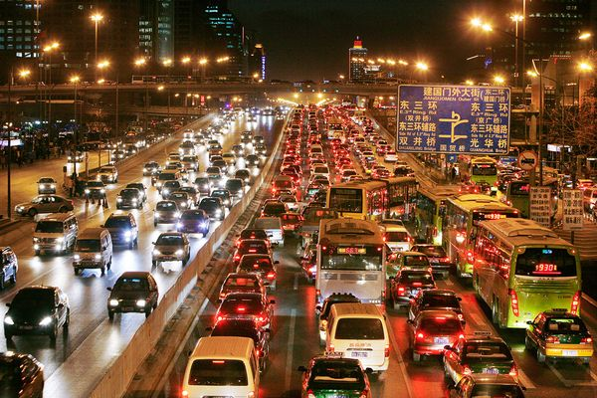
WESTERN STATES PETROLEUM ASSOCIATION
California Energy Facts
We are the third largest fuel consuming entity on earth, behind the US as a whole and all of China
5
Source: California Energy Commission

Slide 6
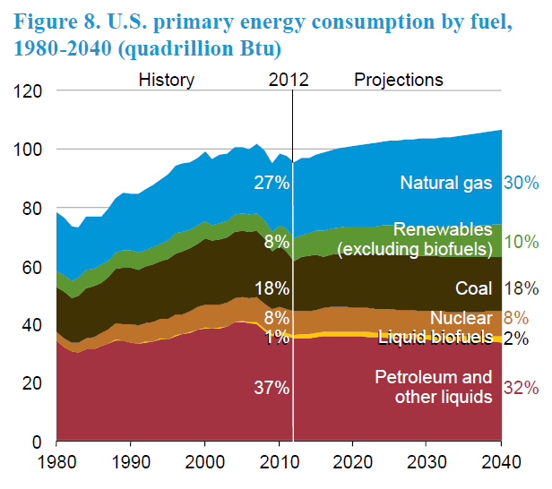
WESTERN STATES PETROLEUM ASSOCIATION
California Energy Reality
By 2040, 80% of US energy will still be supplied by fossil fuels (oil, natural gas, coal)
6
Source: U.S. Energy Information Administration, Annual Energy Outlook 2014
Notes:
The reality check
Petroleum is very much a fuel of the future, along with a wide range of other fuels and technologies. Support diversification of fuel portfolio
Projection by the U.S. Energy Information Administration
Shows that by 2035, more than 80 percent of this country’s energy will still be derived from fossil fuels – oil, natural gas and coal.
And that projection includes an 80 percent increase in the volume of alternative and renewable fuels.
By 2035, those renewable and alternative sources of energy will provide just 4.7 percent of our energy needs, according to the EIA.

Slide 7
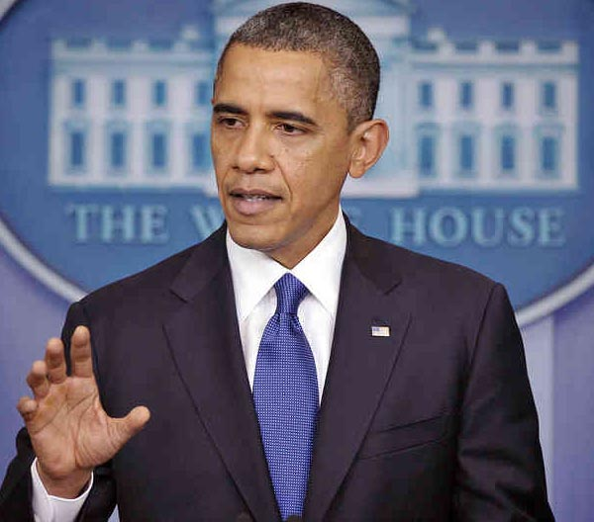
WESTERN STATES PETROLEUM ASSOCIATION
America’s Energy Future
“For the first time in nearly two decades, we now produce more oil here at home than we buy from the rest of the world, and our all-of-the-above strategy for new American energy means lower energy costs.”
President Barack Obama, December 20, 2013
7

Slide 8
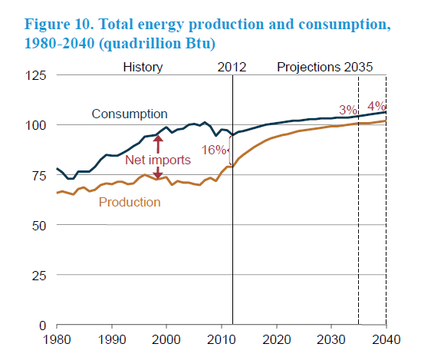
WESTERN STATES PETROLEUM ASSOCIATION
America’s Energy Future: Security, Independence
8
Source: U.S. Energy Information Administration, Annual Energy Outlook 2014

Slide 9
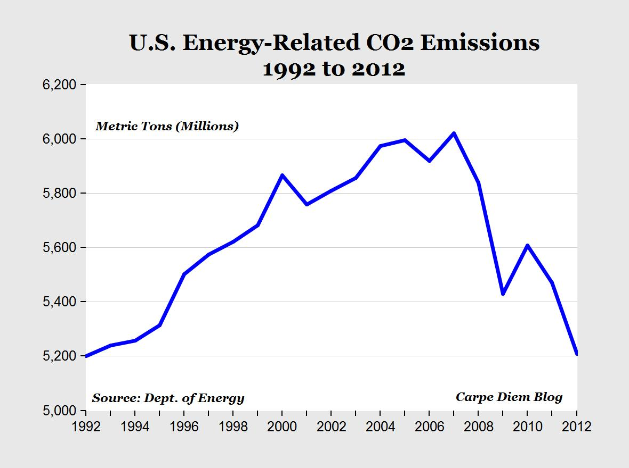
WESTERN STATES PETROLEUM ASSOCIATION
U.S GHG Emissions Are at 20-Year Low
9

Slide 10
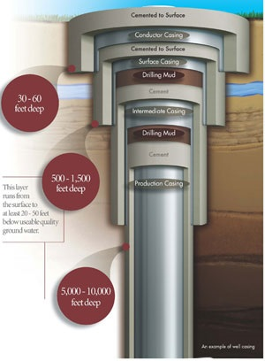
WESTERN STATES PETROLEUM ASSOCIATION
Hydraulic Fracturing in California
Safe and well-established well stimulation technology used in California for 60 years
No indication of adverse effects to the environment or harm to human health and safety in California
Wells designed and constructed to meet the strict regulations & engineering specifications of the Division of Oil, Gas, & Geothermal Resources (DOGGR)
10

Slide 11
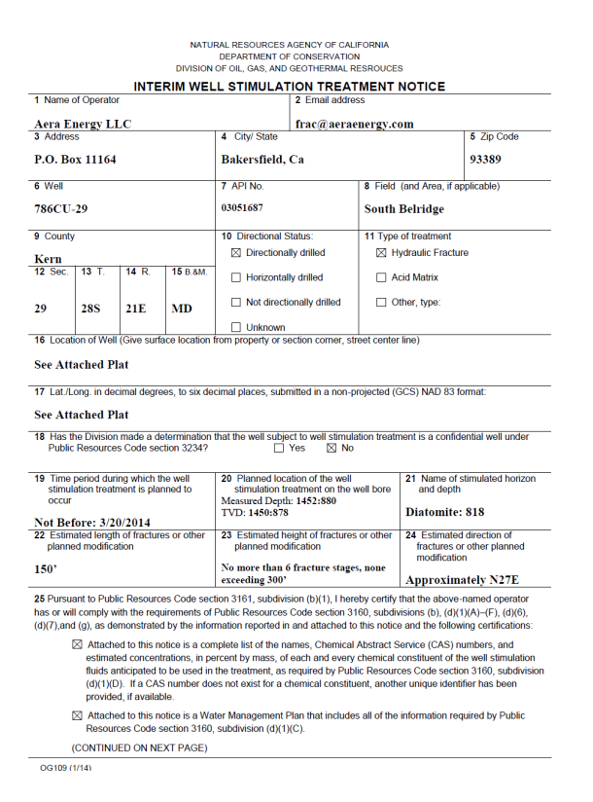
WESTERN STATES PETROLEUM ASSOCIATION
Hydraulic Fracturing: How Much, Where
830 wells fractured in 2013 according to FracFocus
3,091 oil and gas well permits issued in 2013
54,986 wells currently producing oil and/or gas in CA
97% were in Kern County
Interim Well Stimulation Treatment Notice, Division of Oil, Gas & Geothermal Resources
11
Source: WSPA survey of FracFocus website 2013 data
Notes:
11

Slide 12
WESTERN STATES PETROLEUM ASSOCIATION
Hydraulic Fracturing and Water Quality
“Fracking has been around for decades, and there’s a tremendous amount of misinformation out there about it, a lot of fear that I think is unfounded.” Sally Jewell, U.S. Secretary of the Interior, November 8, 2013
“There’s nothing inherently dangerous in fracking that sound engineering practices can’t accomplish.” Gina McCarthy, Current U.S. EPA Administrator, November 4, 2013
“I still have not seen any evidence of fracking per se contaminating groundwater.” Ernest Moniz, U.S Secretary of Energy, August 1, 2013
“The Water Boards generally consider hydraulic fracturing a low threat to groundwater…” State Water Resources Control Board, Executive Director, Thomas Howard, February 8, 2013
“In no case have we made a definitive determination that the fracking process has caused chemicals to enter groundwater.” U.S. Environmental Protection Agency Administrator Lisa Jackson, April 30, 2012
12

Slide 13
Hydraulic Fracturing and Water Use
In 2013, the average amount of water used during hydraulic fracturing operations was 127,000 gallons of water
The total amount of water used in the 830 wells that were hydraulically fractured in 2013 was 323 acre feet
The average golf course requires 312,000 gallons per day
Farming in California uses approximately 34 million acre feet of water annually
“My impression is that the quantity of water used is really very small…You should go after problems that really matter and not go after the de minimis things where it’s rhetorically convenient.”
Jay Lund, Director, Center for Watershed Sciences, University of California Davis
13
Source: FracFocus website, Department of Water Resources, Sierra Club

Slide 14
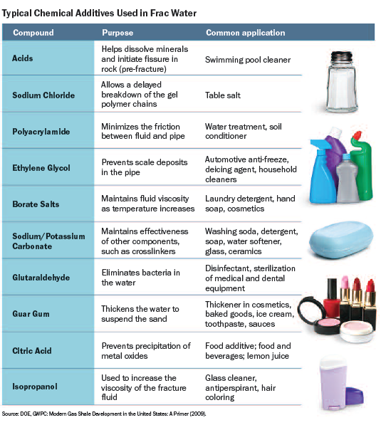
Hydraulic Fracturing Fluid
Hydraulic Fracturing Fluid
14

Slide 15
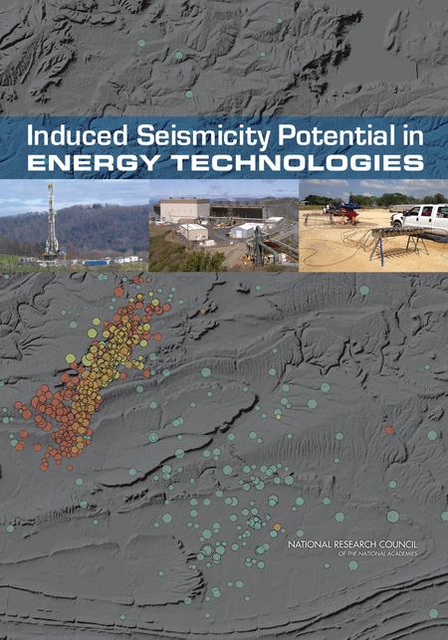
Fracking and Earthquake Risks
“We find there is no evidence to suggest hydraulic fracturing itself is a cause of the increased rate of earthquakes.”
David Hayes, Deputy Secretary, United States Department of the Interior
“Hydraulic fracturing has a low risk for inducing earthquakes that can be felt by people . . .”
National Academy of Sciences, June 15, 2012

Slide 16
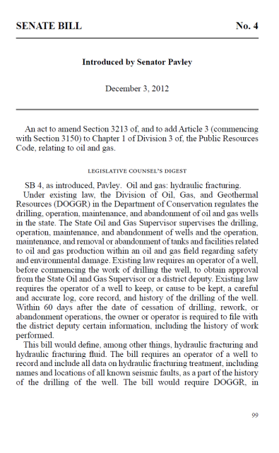
WESTERN STATES PETROLEUM ASSOCIATION
Senate Bill 4
Passed by Legislature September 11, 2013, signed by Governor September 16, 2013
Provides most stringent regulation of hydraulic fracturing in the country
Requires:
Prior notification to surrounding land owners
Mandatory disclosure of fracturing fluid
Well integrity testing before and after fracturing
Testing of nearby drinking water sources
Development of water management plans and environmental impact reports
Independent, science-based study of hydraulic fracturing
16
Source: Senate Bill 4, September 20, 2013

Slide 17
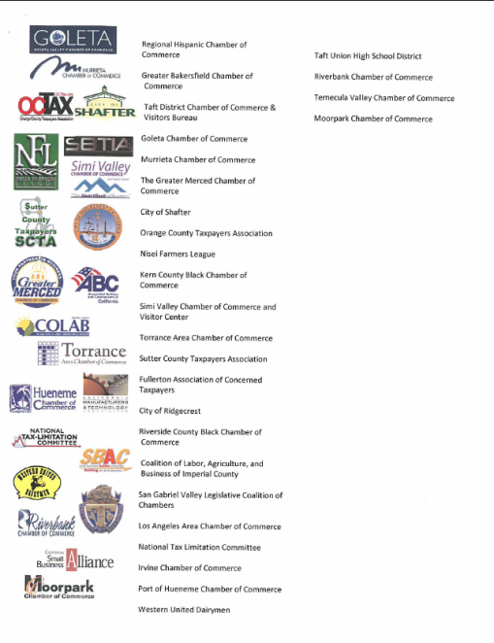
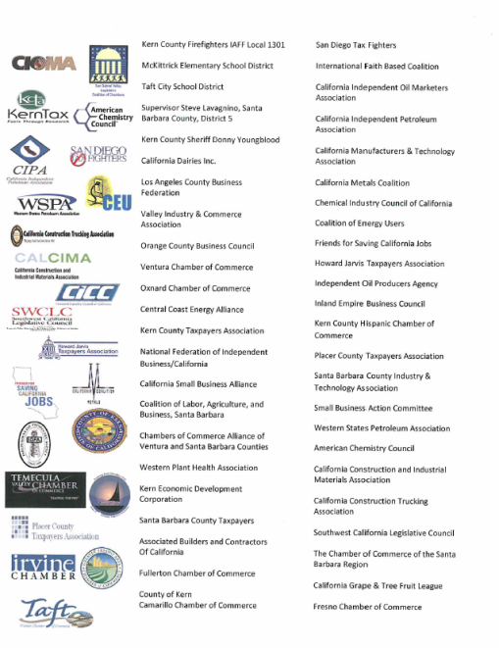
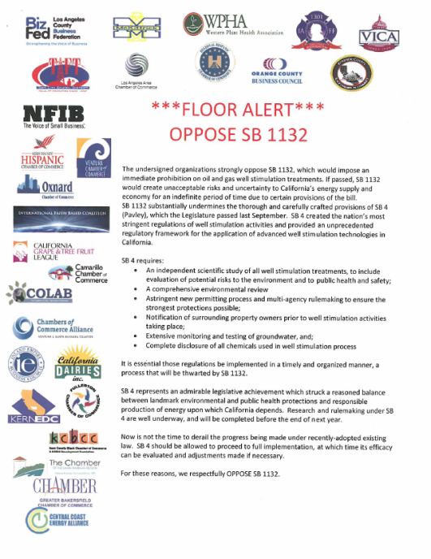
WESTERN STATES PETROLEUM ASSOCIATION
Senate Bill 1132 – Opposed
Measure would create unacceptable risks and uncertainty to California’s energy supply and economy for an indefinite period of time
Substantially undermines the thorough and carefully crafted provisions of SB 4
SB 4 represents an admirable legislative achievement which struck a reasoned balance between landmark environmental and public health protections and responsible production of energy upon which California depends
17

Slide 18
WESTERN STATES PETROLEUM ASSOCIATION
EIA Forecast of Monterey Shale
U.S. officials cut estimate of recoverable Monterey Shale oil by 96%
While technically recoverable resources (TRR) is a useful concept, changes in play-level TRR estimates do not necessarily have significant implications for projected oil and natural gas production, which are heavily influenced by economic considerations that do not enter into the estimation of TRR.
Shirley Neff, Senior Advisor
U.S. Energy Information Administration
By Louis Sahagun
Federal energy authorities have slashed by 96% the estimated amount of recoverable oil buried in California's vast Monterey Shale deposits, deflating its potential as a national "black gold mine" of petroleum.
Just 600 million barrels of oil can be extracted with existing technology, far below the 13.7 billion barrels once thought recoverable from the jumbled layers of subterranean rock spread across much of Central California, the U.S. Energy Information Administration said.
18

Slide 19
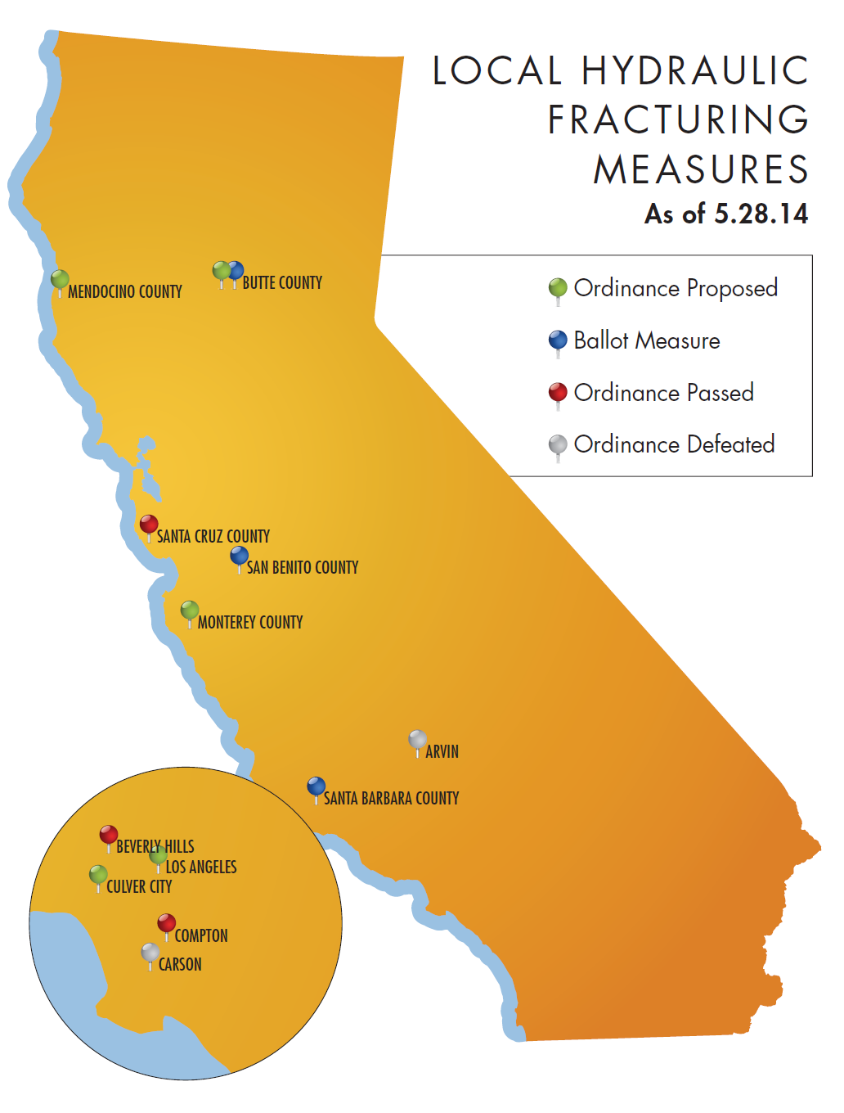
19

Slide 20
WESTERN STATES PETROLEUM ASSOCIATION
20

Slide 21
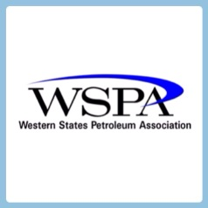
WESTERN STATES PETROLEUM ASSOCIATION
Follow Us on Twitter
@WSPAPrez
@OfficialWSPA
www.wspa.org
21

